Slide 1
Introduction
Westerville Caring & Sharing (WC&S) was founded in 1988 by the Westerville Area Chamber of Commerce and the Westerville YWCA to reach out to Westerville City School District students and families who are in need. We are an all-volunteer, community-centered organization.
Notes:
Voice over text

Slide 2

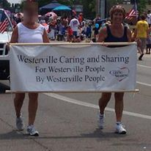

Slide 3
Westerville Caring and Sharing started as a holiday program for families who were having economic difficulties due to low-paying jobs, illness, job loss, or disaster. Our purpose is to help people get back on their feet, especially around back-to-school and holiday time.
We have been helping the Westerville community for 30 years and will continue our commitment to the community for many more years. Westerville Caring and Sharing is one of a few 501(c)3 charities in the Westerville community that is all-volunteered based. Although many people volunteer for the two annual programs—Back-to-School and the Holiday Project, WC&S has a core of ten to twelve individuals who plan and organize these endeavors.
Notes:
Voice over text

Slide 4
Our mission is to encourage individuals, businesses, civic, church, and school groups in the Westerville area to care for the less fortunate and to share their resources of time, funds, and energy.
Notes:
Voice over text

Slide 5
(Picture) to encourage individuals, businesses, civic, church, and school groups in the Westerville area to care for the less fortunate and to share their resources of time, funds, and energy
Notes:
Please make this into a creative piece

Slide 6
We serve Westerville school students who qualify for the subsidized lunch program. Many people in the Westerville and in the Columbus metropolitan areas have the perception that there are no low-income people living in Westerville. Even though the median income is high, a large number of Westerville students are on the free and reduced-price lunch program.
Notes:
Voice over text

Slide 7
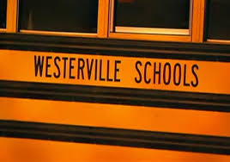

Slide 8
Over the years we have raised awareness on the need for donations. Without these donations, we could not give the students the necessary school supplies or holiday gifts every year.
Examples of various fundraising activities that occurred over the years:
WC&S garage sale
Raffles from various organizations
Neighborhood toy sale
Westerville Chamber of Commerce’s Evening of Elegance
Westerville elementary students saving pennies
Westerville middle and high school students collecting money
Restaurants donating a percentage of sales on a given day
Notes:
Voice over text

Slide 9
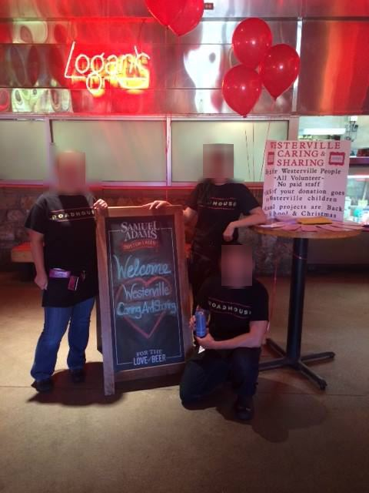

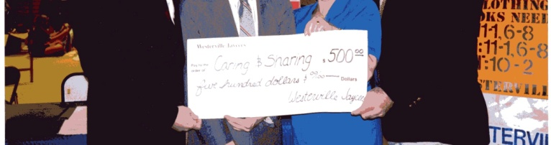
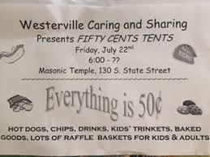
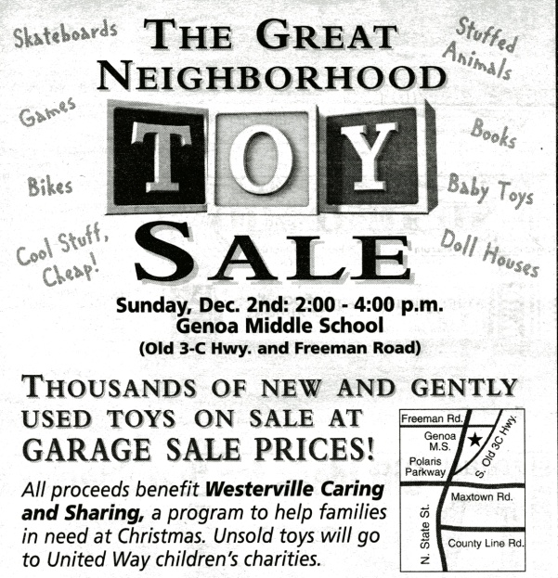

Slide 10
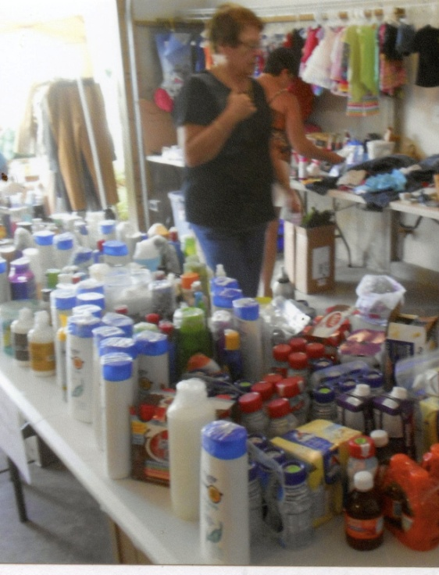


Slide 11
Signature Programs
Our two signature programs are our Back to School Project and our Holiday Project.
The Back-to-School project is designed to help families with school-aged children who might be overwhelmed in providing school supplies and clothing. We assists students and their families with book bags, age-appropriate school supplies, and clothing gift certificates. In addition to school supplies, personal hygiene products are also given as these items cannot be purchased with a EBT or SNAP card. In the 2016-2017 school year, over 4600 Westerville school students qualified for subsidized meals. This is a 120% student increase over the number of students who qualified in the 2010-2011 school year. It is important that these students start the school year on an equal footing with their peers. We served over 9,000 students over the last 30 years.
Notes:
Voice over text

Slide 12
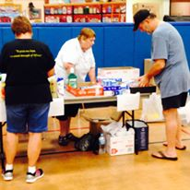
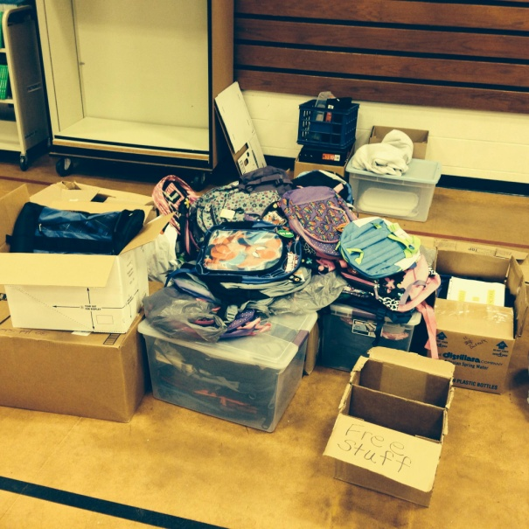
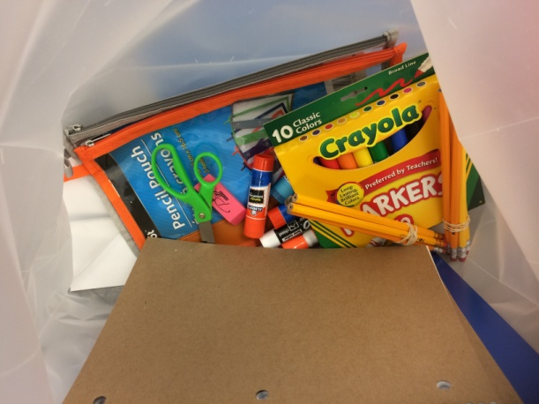
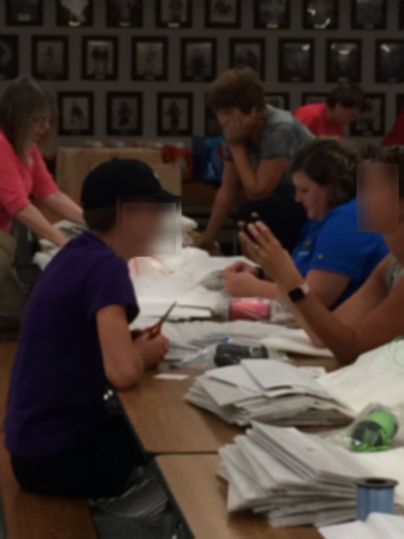

Slide 13
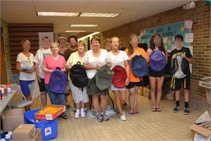
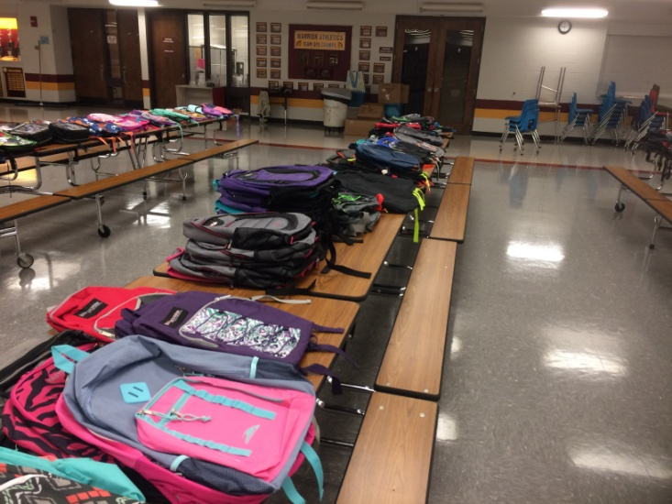
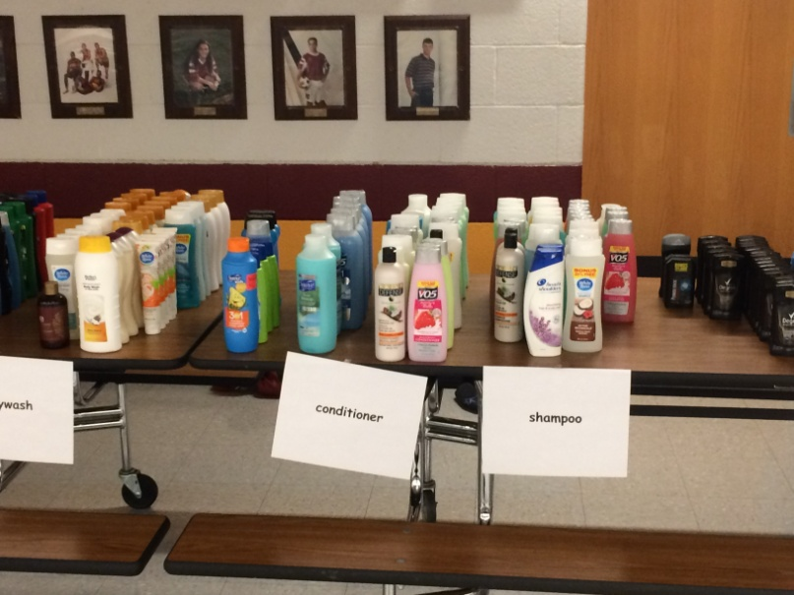

Slide 14
The Holiday Project helps students and their families with items from their wish list, food basket, gift certificates, and personal hygiene products through a sponsorship, consisting of individuals and/or businesses/organizations. The Holiday Project has two components—Christmas Gift Sponsorship and Food Drive.
The Christmas sponsorship is a community-wide project where we recruit sponsors to provide items from a student’s wish list. Students, parents, and/or guardians fill out a wish-list where requests for clothing, toys, electronics, books, etc are listed. A sponsor is then matched with a student or students to purchase items from the wish list. The sponsors then deliver the gifts to the distribution site.
We served over 13,500 students over the last 30 years.
Notes:
Voice over text
Robert, have a video that was done where I talk about our Holiday project; link is below so that you can incorporate some of it into this video. Also, use whatever music you feel fits.
Bounce TV video: https://www.dropbox.com/sh/fdfb78lyiu3p75b/AAB4Gk2dPaoHRCSHSs-LATQpa?dl=0

Slide 15

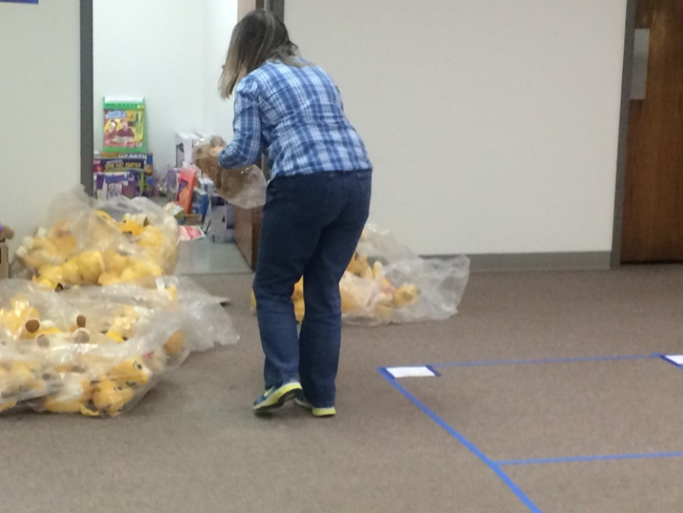
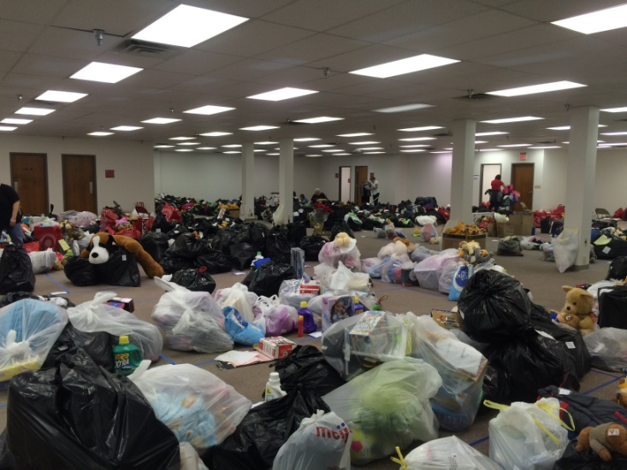
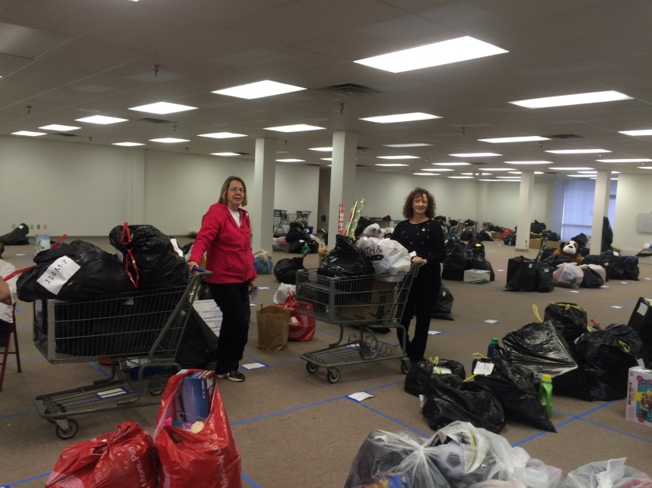

Slide 16
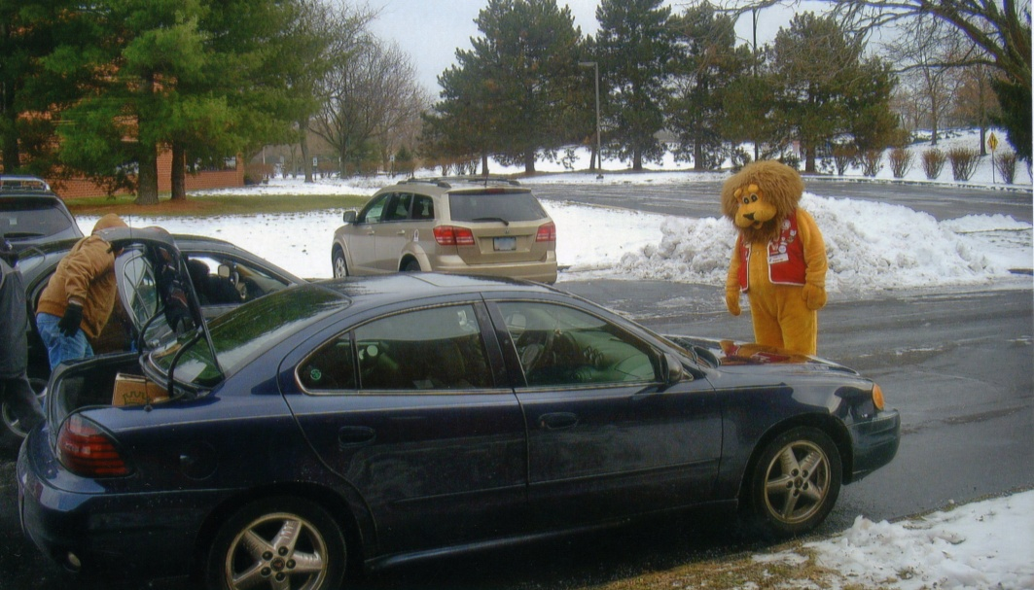
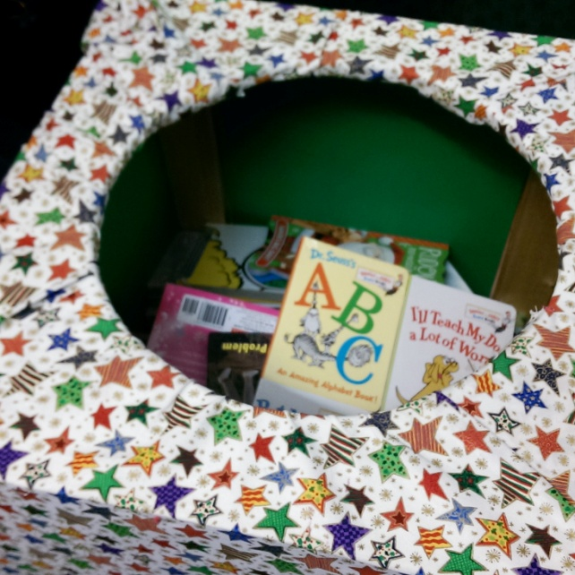
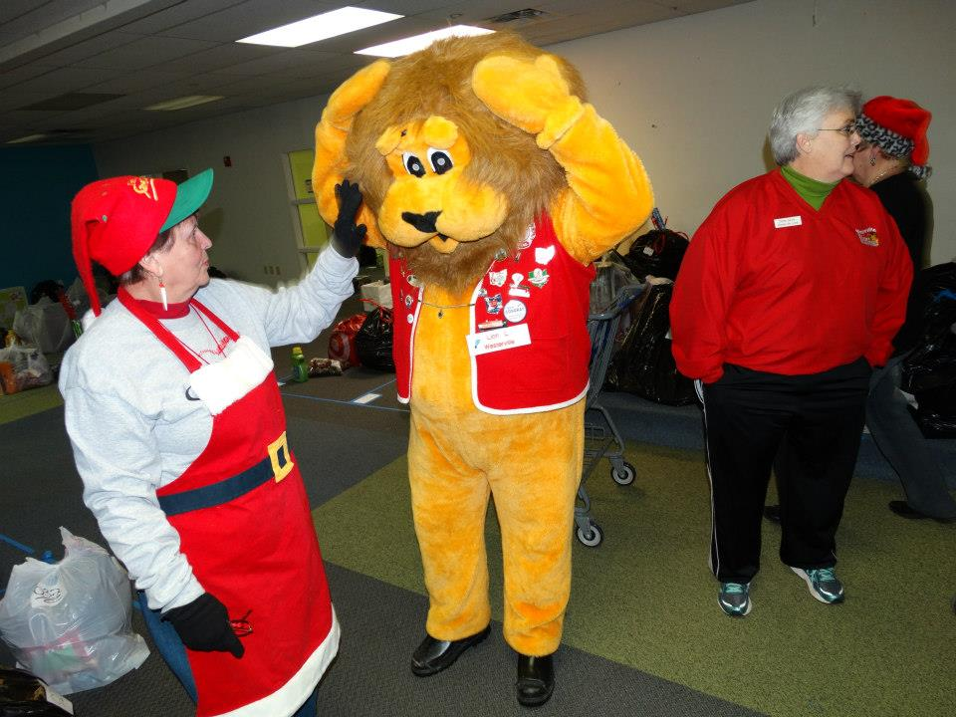

Slide 17
When schools are in recess, many students may not have access to food. The Holiday Project Food Drive provides extra food for the students and their families, to ensure that no one goes hungry.
The food drive is a community-wide project. Over 50 Westerville community businesses allow donation boxes to be placed on their premises. In addition, organizations, civic groups, city employees, and the school district have their own food drives, and donate what they collect to Westerville Caring & Sharing.
Notes:
Voice over text

Slide 18
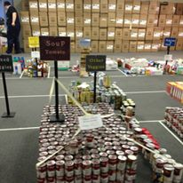
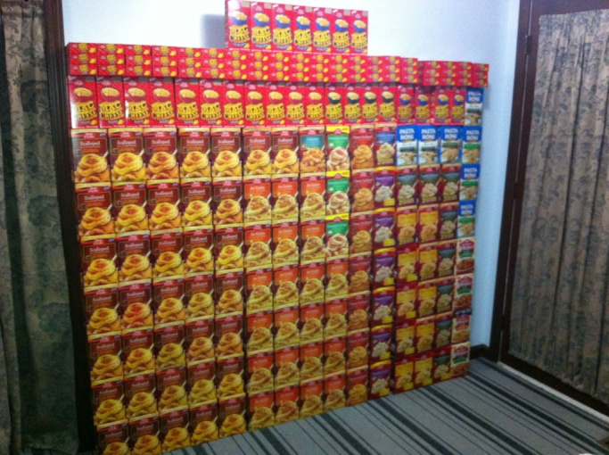
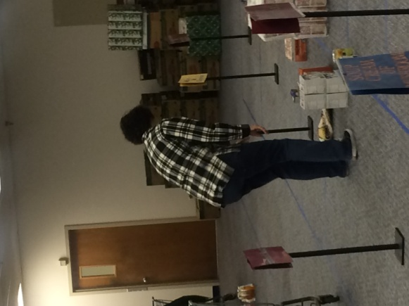
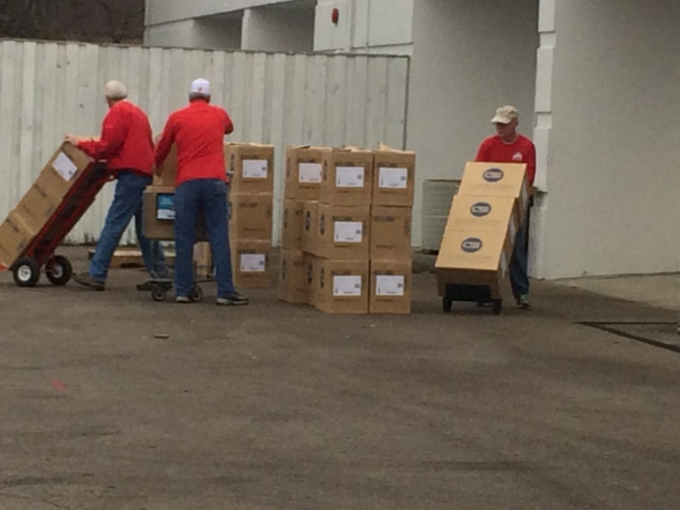
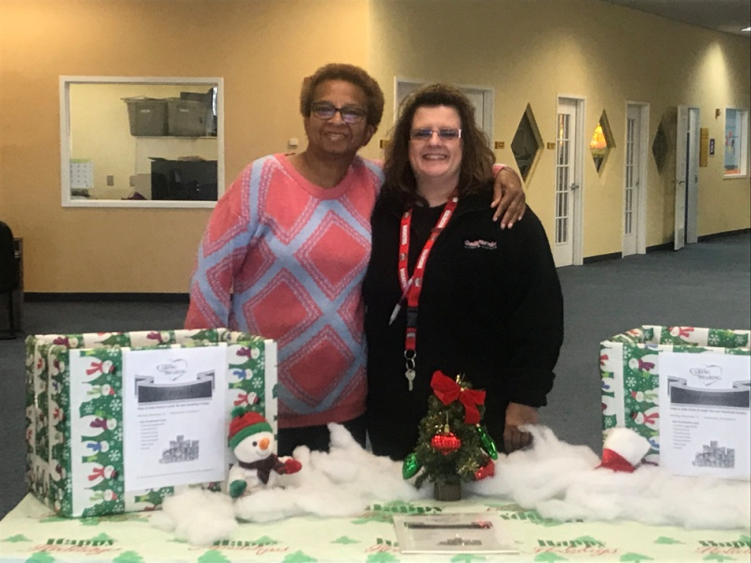

Slide 19
Community Involvement
Over the years we have raised awareness on the need for donations for both the Back-to-School Project and the Holiday Project. Without the support of the community, we could not give the students and their families the necessary school supplies or holiday gifts every year. The community’s involvement revolves around four key areas—
sponsoring a child or a teenager at Christmas time
giving a financial donation,
volunteering their time, and
organizing a food drive.
Notes:
Voice over text

Slide 20
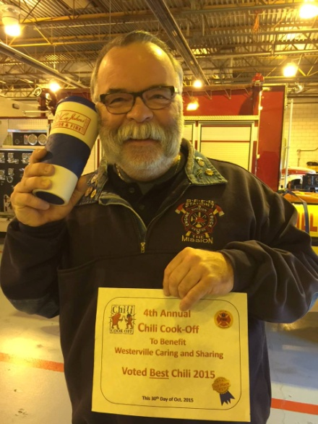
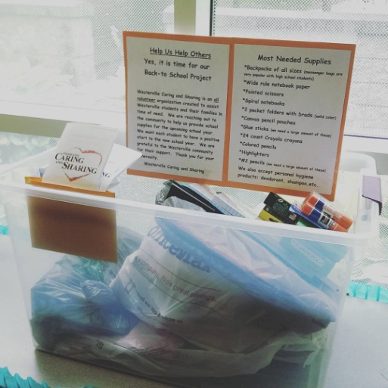
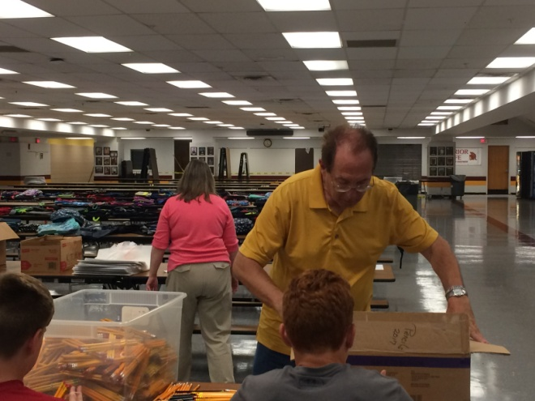
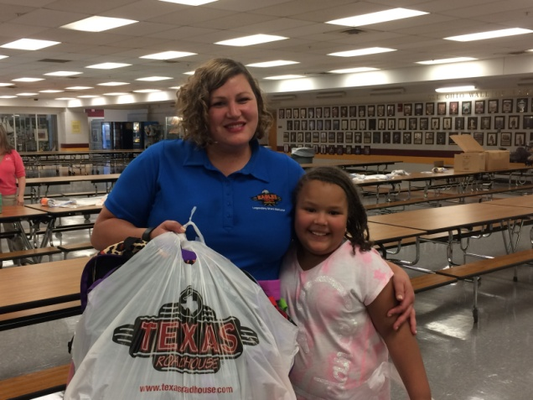

Slide 21
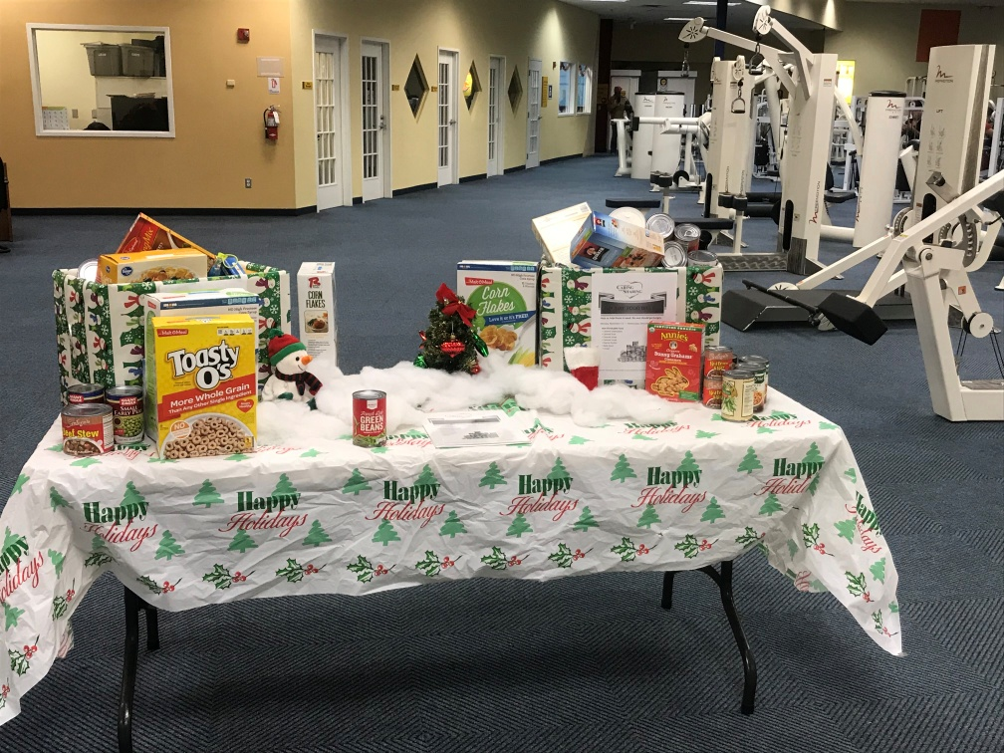
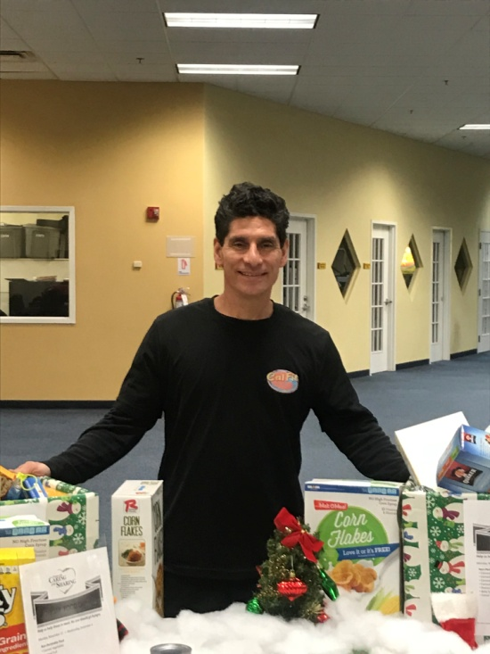

Slide 22
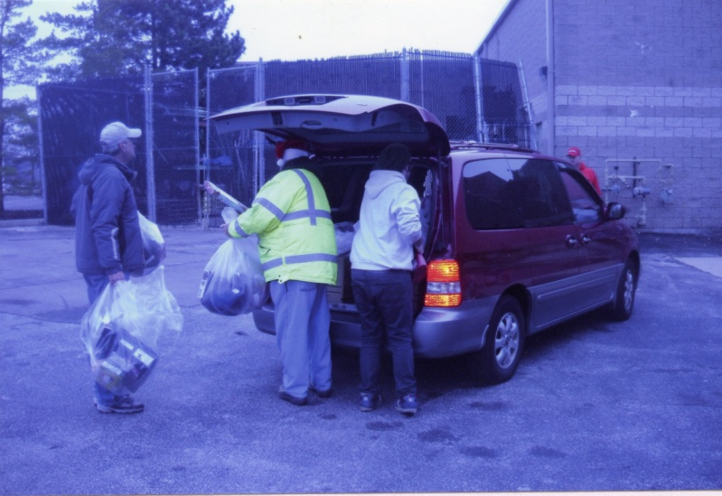
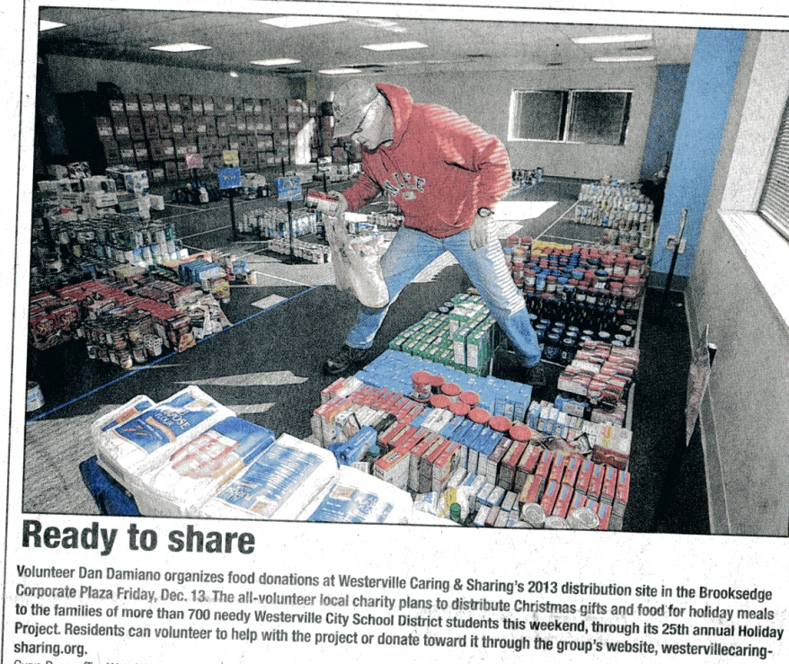
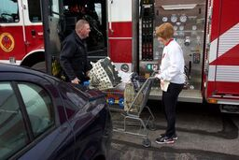

Slide 23
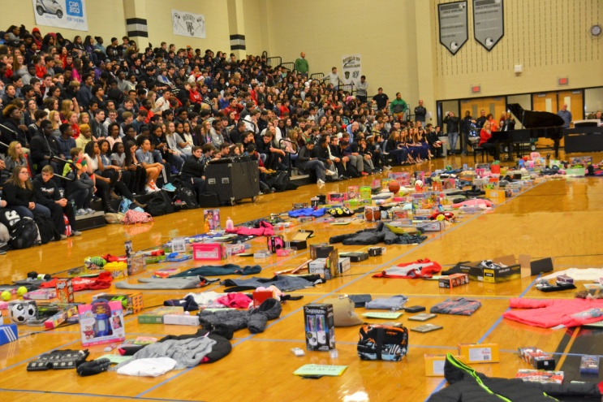
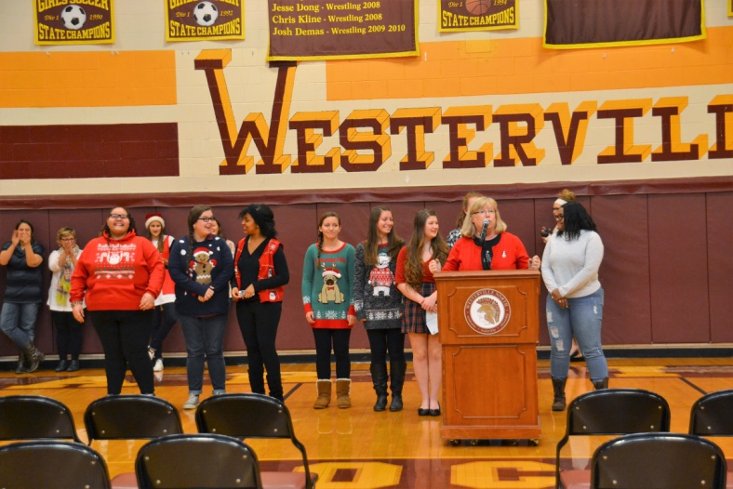
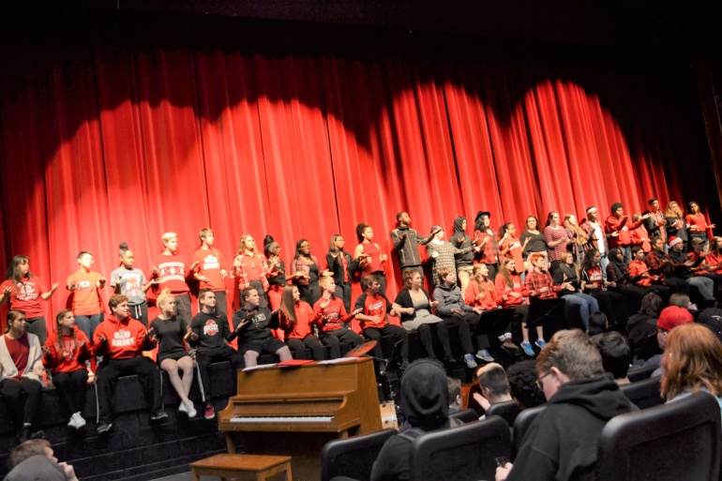

Slide 24
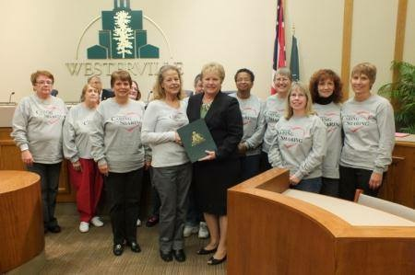
Community Recognition
In 2013, the Westerville City Council honored Westerville Caring & Sharing for 25 years of community service.
Notes:
Voice over text

Slide 25
In 2005, the Rotary Club of Westerville gave us the A. Monroe Courtright Community Service Award.
Notes:
Voice over text
Robert: we do not have a picture for this; suggestions on what we can use?

Slide 26
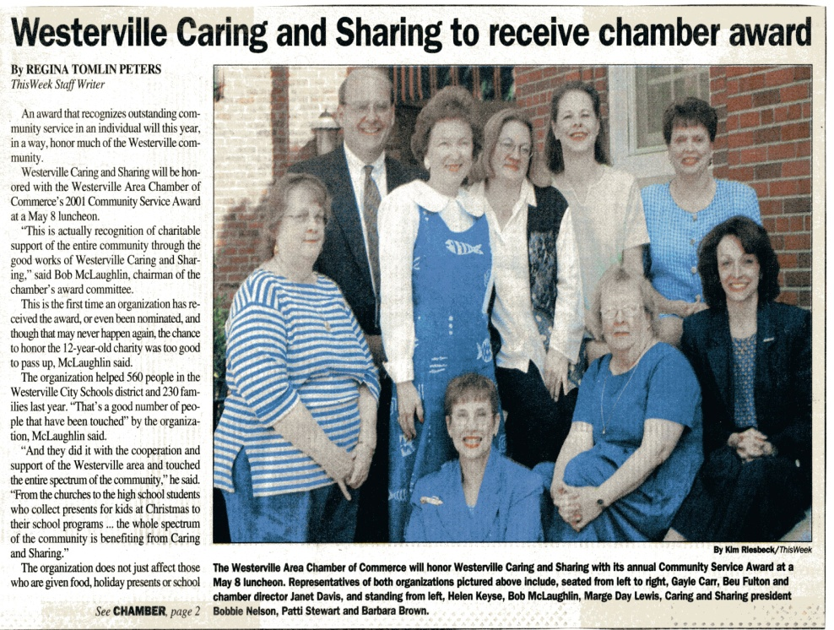
In 2001, we received the Westerville Area Chamber of Commerce Service Award.
Notes:
Voice over text

Slide 27
In 2001, we received the Columbus Dispatch Community Service Award.
Notes:
Voice over text
Robert: we do not have a picture for this; suggestions on what we can use?

Slide 28
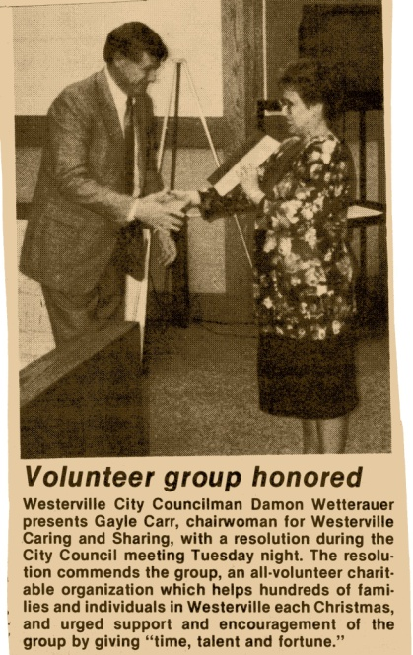
In 1991, Westerville City Council presented a resolution to Westerville Caring and Sharing for helping individuals and families at Christmas time.
Notes:
Voice over text

Slide 29
Our Volunteers
Over our 30 years of service, we had many volunteers who have served the Westerville community. Without their dedication for service, Westerville Caring and Sharing would not have lasted for 30 years.
Notes:
Voice over text

Slide 30
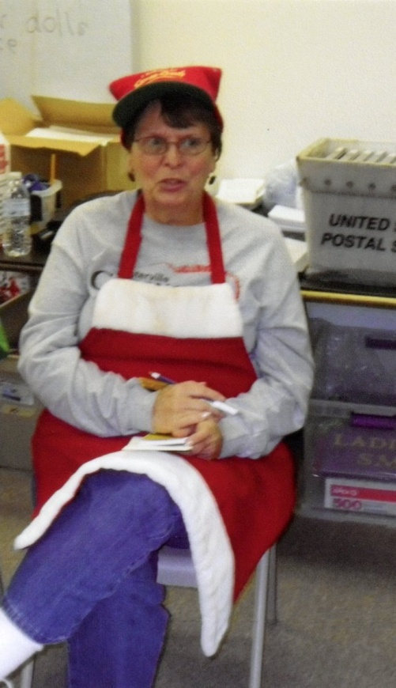
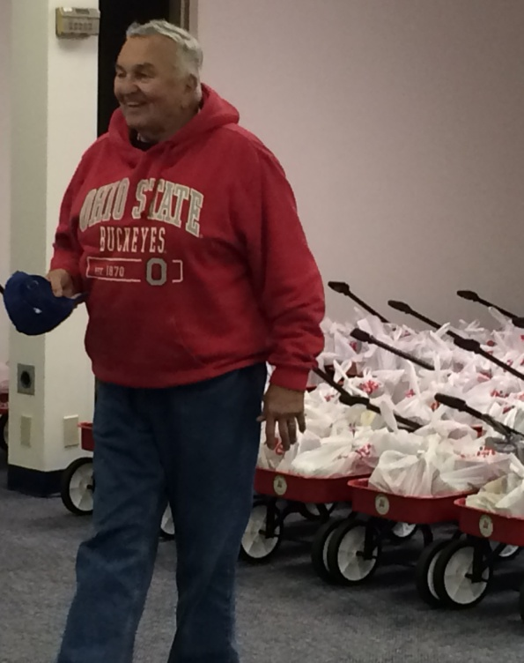
Barbara and Don

Slide 31
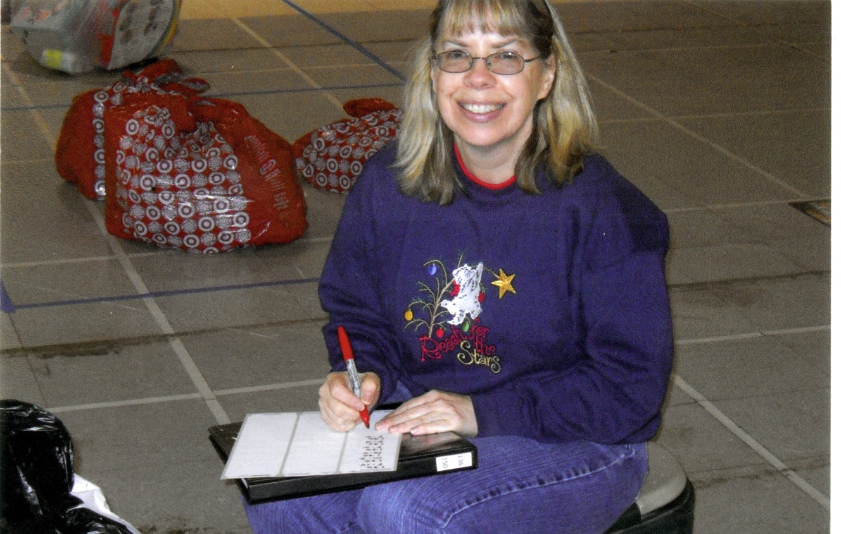
Paula

Slide 32
Connie and Rick

Slide 33
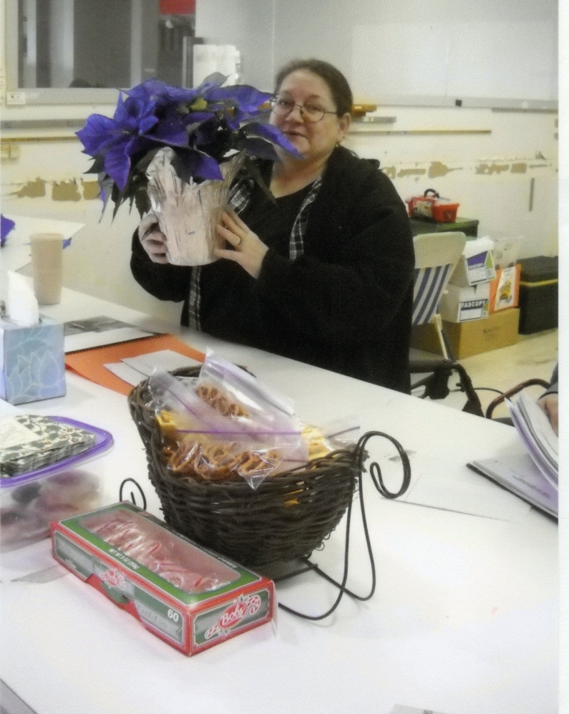
Bobbie

Slide 34
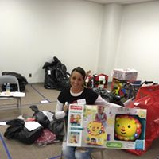
Michelle B

Slide 35
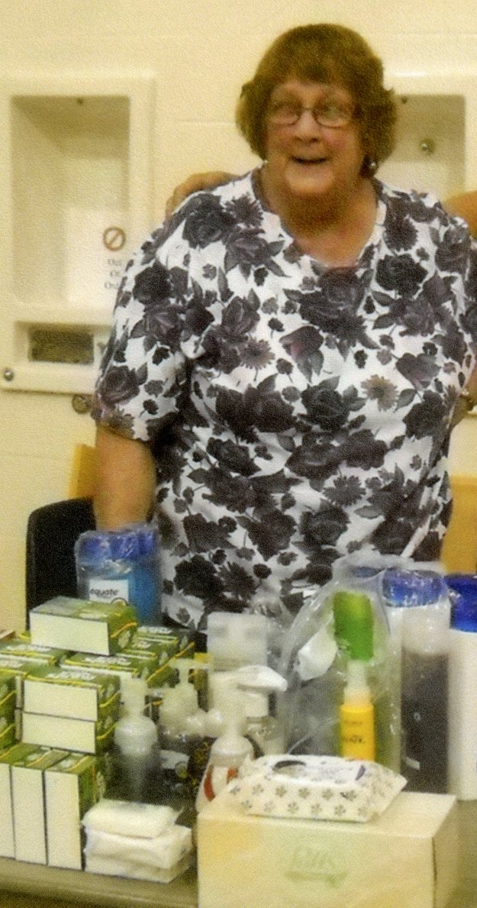
Helen

Slide 36
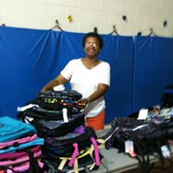
Michelle W

Slide 37
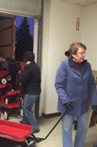
Charlene

Slide 38

Michelle W

Slide 39
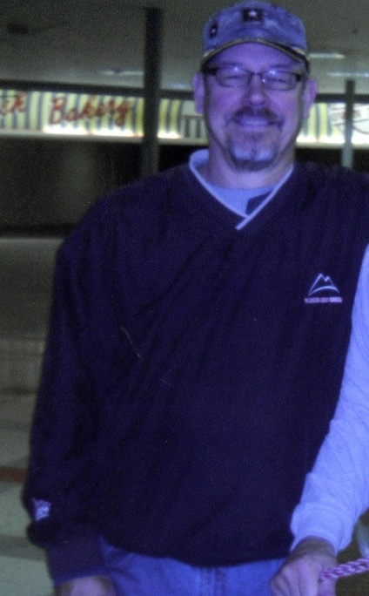
Gary

Slide 40
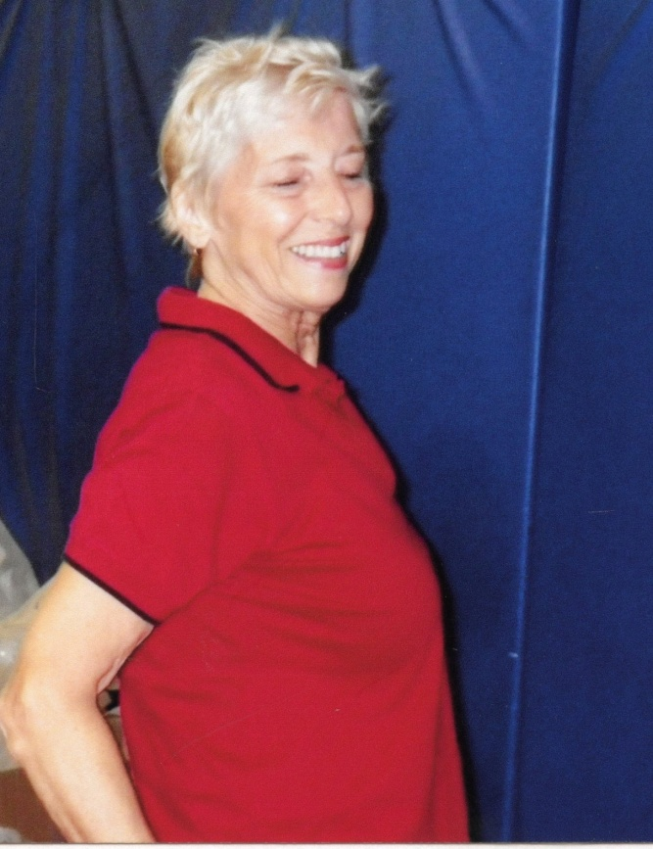
Donna

Slide 41

Scott

Slide 42

Anne

Slide 43

Marilyn

Slide 44


Patti and Jimmy
Notes:
NOTE: This is the last slide of volunteers with Jimmy’s picture being the last photo. It states: “In Loving Memory”, (photo) “1953-2014”

Slide 45
The volunteers of Westerville Caring and Sharing would like to thank the Westerville community for supporting us for 30 years. Without your involvement, we cannot do what we do. We look forward to your continuing work with us.
Notes:
Voice over text

Slide 46


Slide 47
Credits
Photo Credit:
Westerville Public Library
Westerville Caring and Sharing
This Week Westerville New and Public Opinion
Westerville City Schools
William Bretthauer
The City of Westerville Fire Department
Written by Michelle Watts
Produced by Robert Butler
Notes:
Please update as to how it should look

